Slide 1
Course
« Deep Learning »
Sid-Ahmed Berrani
ENSIA
2024 – 2025

Slide 2
3. Deep Neural Network
Optimization
The training step is highly time-consuming.
It requires optimization.
Optimization can deal with:
  The way the training dataset is processed.
  Weights adaptation.

Slide 3
3. Deep Neural Network
Optimization: Mini-batch gradient descent
Training in a huge dataset → Training is slow
On batch gradient descent:
  Weights are modified only when the whole dataset is processed.
  Training is slow
If m= 10⁷:
We divide the dataset into mini-batches of 1000 examples each.
$$X = \left[x^{(1)}x^{(2)}…{ x}^{\left(1000\right)}\left|x^{\left(1001\right)}… x^{\left(2000\right)}\right| … x^{\left(m\right)}\right]$$
(n_{x},m)
$$Y= \left[y^{\left(1\right)}y^{(2)}…{ y}^{\left(1000\right)}\left|y^{\left(1001\right)}… y^{\left(2000\right)}\right| … y^{\left(m\right)}\right]$$

Slide 4
3. Deep Neural Network
Optimization: Mini-batch Gradient Descent
$$X= \left[x^{(1)}x^{(2)}…{ x}^{\left(1000\right)}\left|x^{\left(1001\right)}… x^{\left(2000\right)}\right| … x^{\left(m\right)}\right]$$
For all the mini-batches:
Perform forward propagation using the one mini-batch
Compute the cost using only the considered mini-batch
Implement backpropagation to compute gradients
Update weights
Until going thru the whole dataset => One epoch.
$$Y= \left[y^{\left(1\right)}y^{(2)}…{ y}^{\left(1000\right)}\left|y^{\left(1001\right)}… y^{\left(2000\right)}\right| … y^{\left(m\right)}\right]$$
Notes:
Whereas with batch gradient descent, a single pass through the training set allows you to take only one gradient descent step. With mini-batch gradient descent, a single pass through the training set, that is one epoch, allows you to take 5,000 gradient descent steps. Now of course you want to take multiple passes through the training set which you usually want to, you might want another for loop for another while loop out there. So you keep taking passes through the training set until hopefully you converge or at least approximately converged.
When you have a large training set, mini-batch gradient descent runs much faster than batch gradient descent and that's pretty much what everyone in Deep Learning will use when you're training on a large data set.

Slide 5
3. Deep Neural Network
Optimization: Mini-batch Gradient Descent
Cost
Cost
Iterations
(Batch mode)
Iterations
(Mini-batch mode)

Slide 6
Deep Neural Network
Optimization: Mini-batch Gradient Descent
What about the size of the mini-batch?
The mini-batch size should be between the two extreme cases:
if (mini-batch size = m) : Batch gradient descent.
if (mini-batch size = 1) : stochastic gradient descent.
(The term "stochastic" indicates that the singe example is chosen at random).
Mini-batch stochastic gradient descent: Mini-batch GD where examples of each mini-batch are randomly chosen.
Notes:
With SGD : we loose speedup from vectorization
With Batch GD : Too long per iteration, specially when training dataset is too large.
With Mini-batch: the fastest learning / Take advantage of vectorisation / makes progress without processing the entire training set.

Slide 7
3. Deep Neural Network
Optimization: Mini-batch Gradient Descent
What about the size of the mini-batch?
Remember: The mini-batch mode is useful when the training set is very large in order to reduce the cost of the training.
It is important to make sure that the mini-batch fits in the CPU/GPU memory of the machine.
=> It depends on the application and the size of a single training example.
In practice:
If the size of the training dataset < few thousands of examples => Use the batch mode.
Otherwise => 64 128 256 1024 … 2^{k}
The mini-batch size is a hyper-parameter.

Slide 8
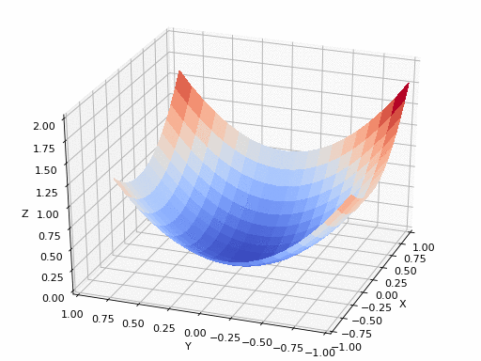
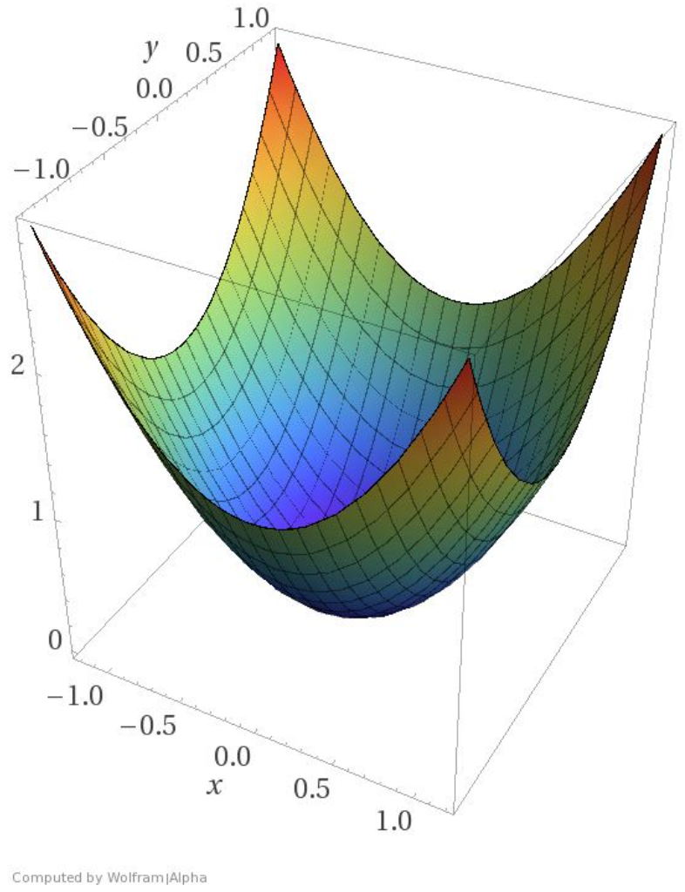
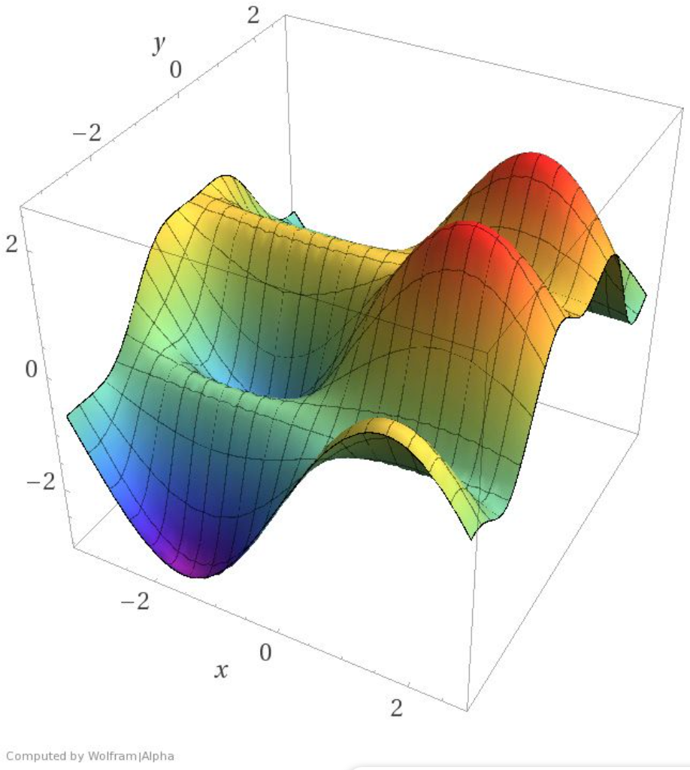
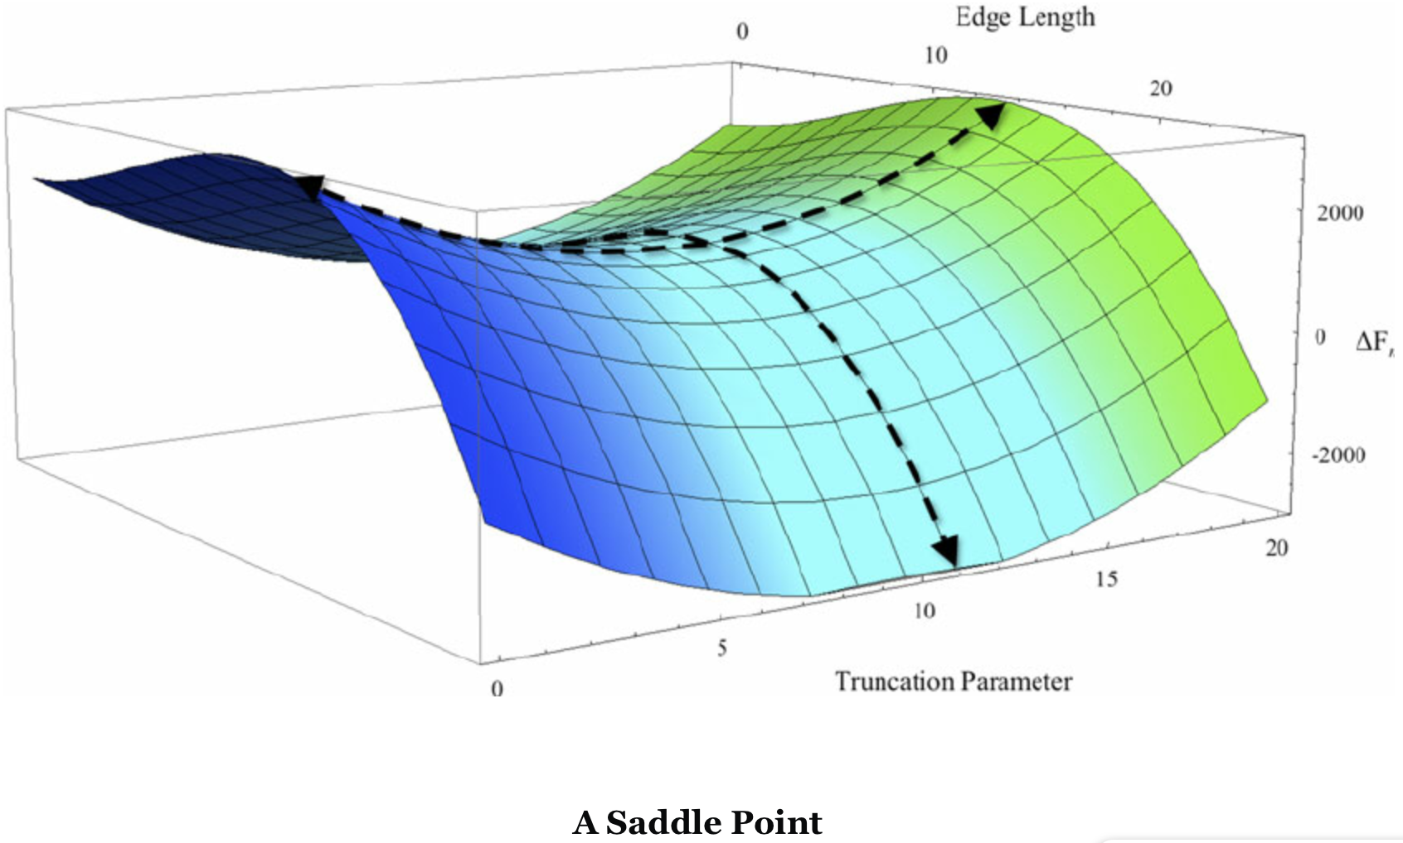
3. Deep Neural Network
Optimization: Grad. Descent Analysis
Gradient descent suffers from:
Local minima
Saddle points
Notes:
https://blog.paperspace.com/intro-to-optimization-in-deep-learning-gradient-descent/
https://blog.paperspace.com/intro-to-optimization-momentum-rmsprop-adam/
Grad descent:
The basic lesson we took away regarding the limitation of gradient descent was that once it arrived at a region with gradient zero, it was almost impossible for it to escape it regardless of the quality of the minima.
Saddle:
A saddle point gets it's name from the saddle of a horse with which it resembles. While it's a minima in one direction (x), it's a local maxima in another direction, and if the contour is flatter towards the x direction, GD would keep oscillating to and fro in the y - direction, and give us the illusion that we have converged to a minima.

Slide 9
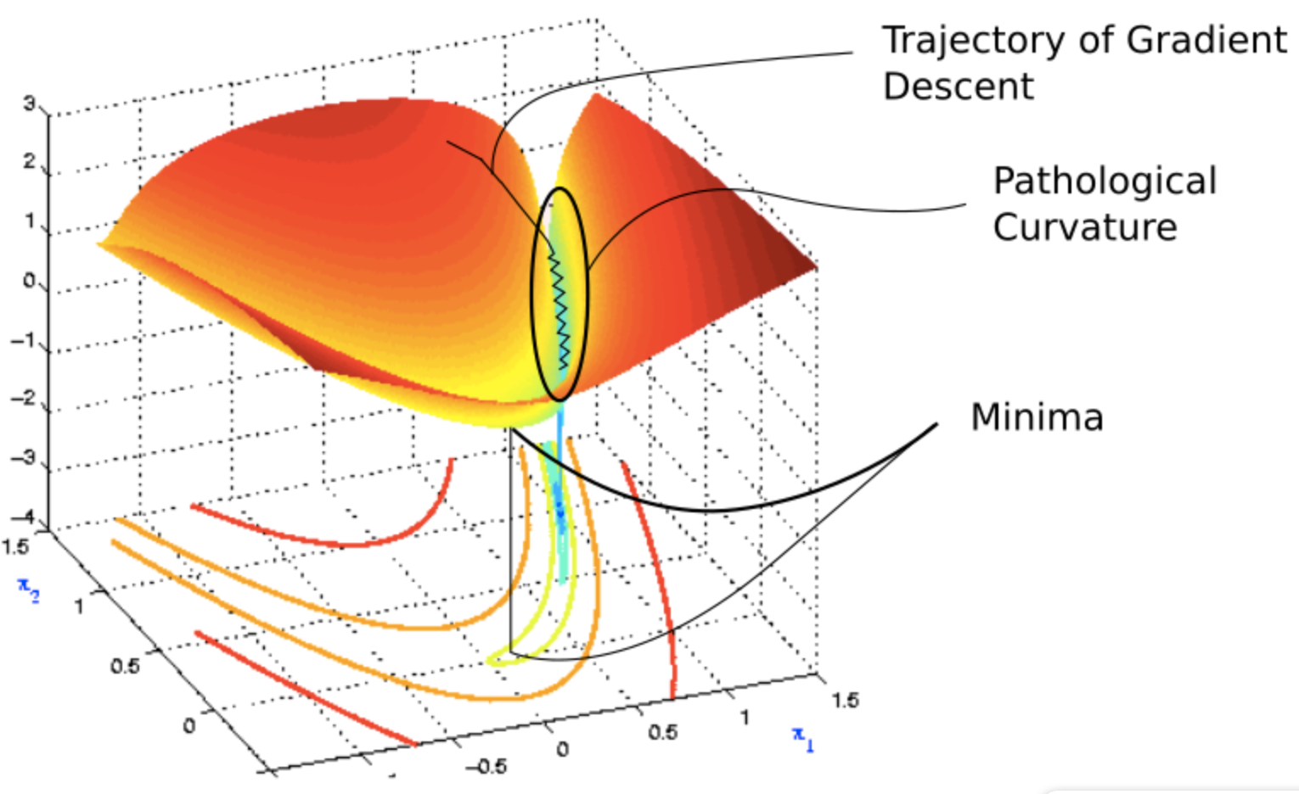
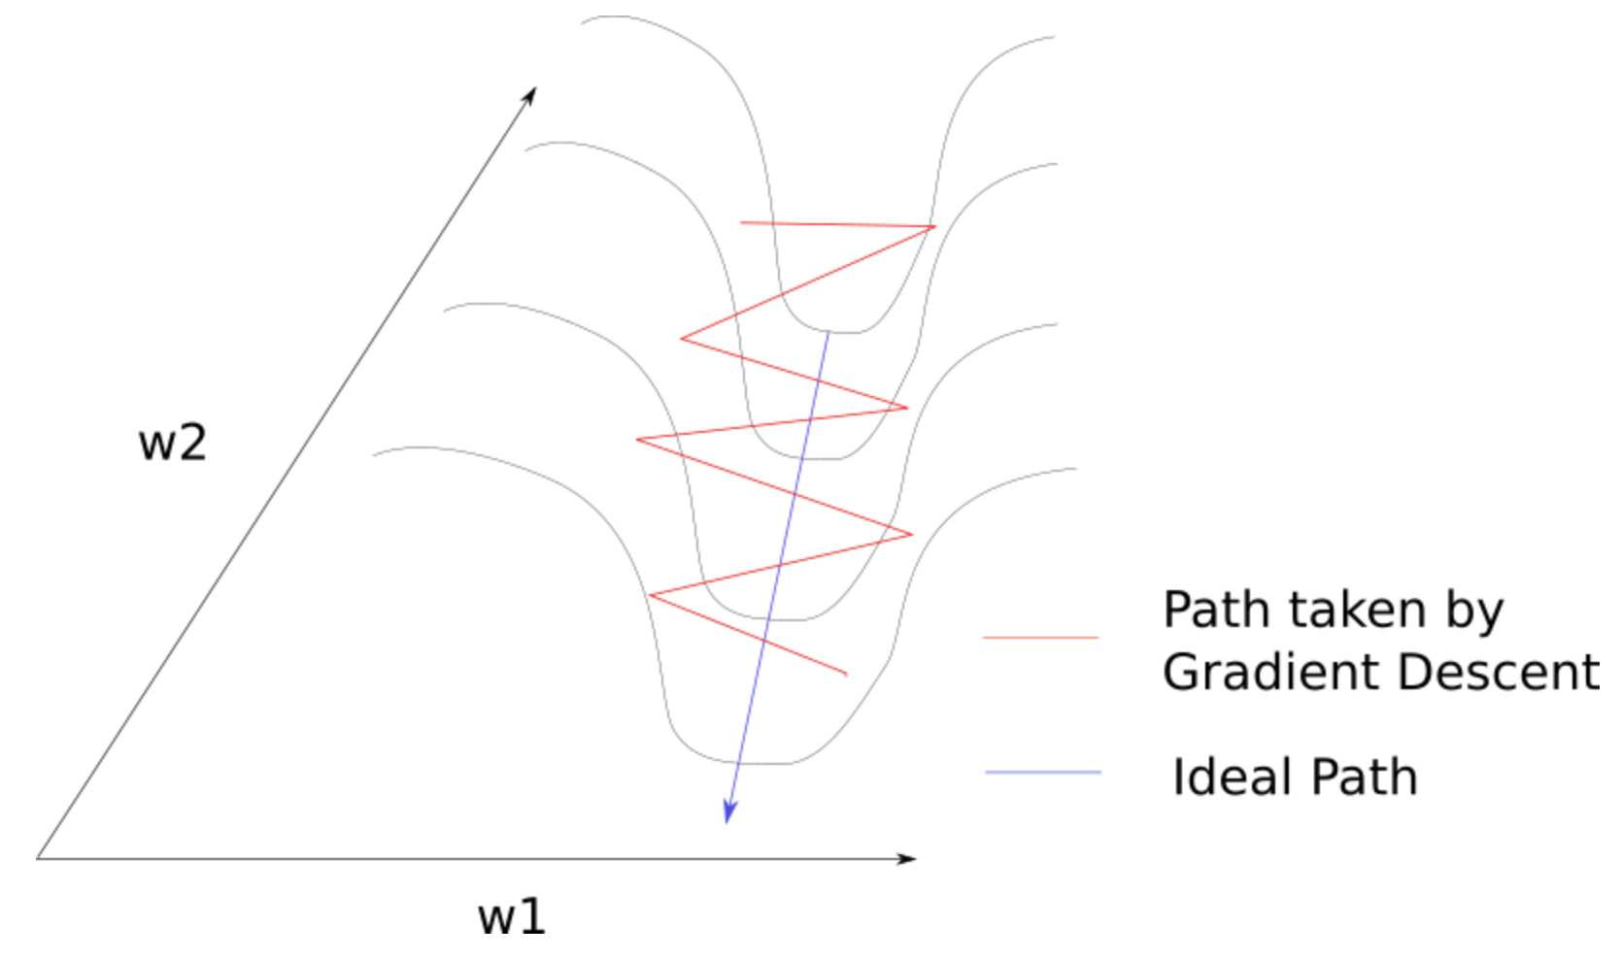
3. Deep Neural Network
Optimization: Grad. Descent Analysis
Gradient descent suffers from:
Pathological Curvature
Notes:
https://blog.paperspace.com/intro-to-optimization-momentum-rmsprop-adam/
Suboptimal solution.
A slow convergence.

Slide 10
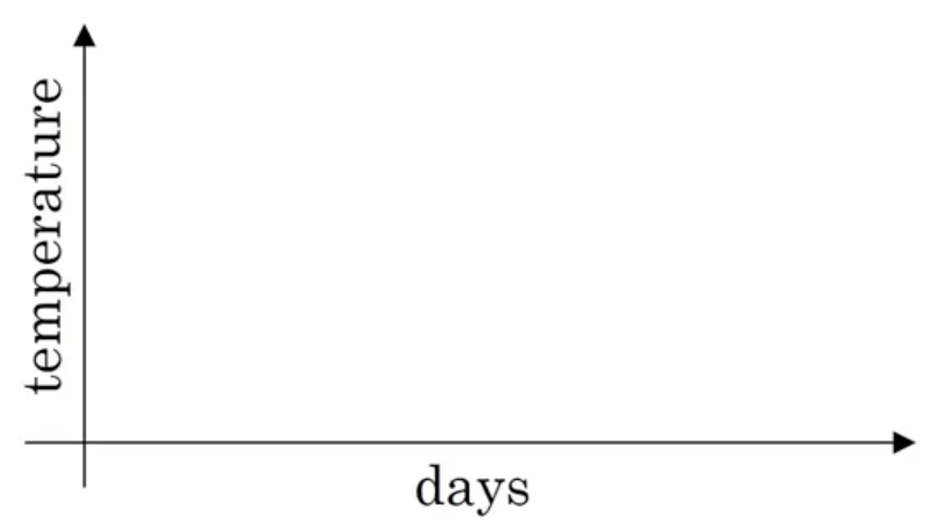
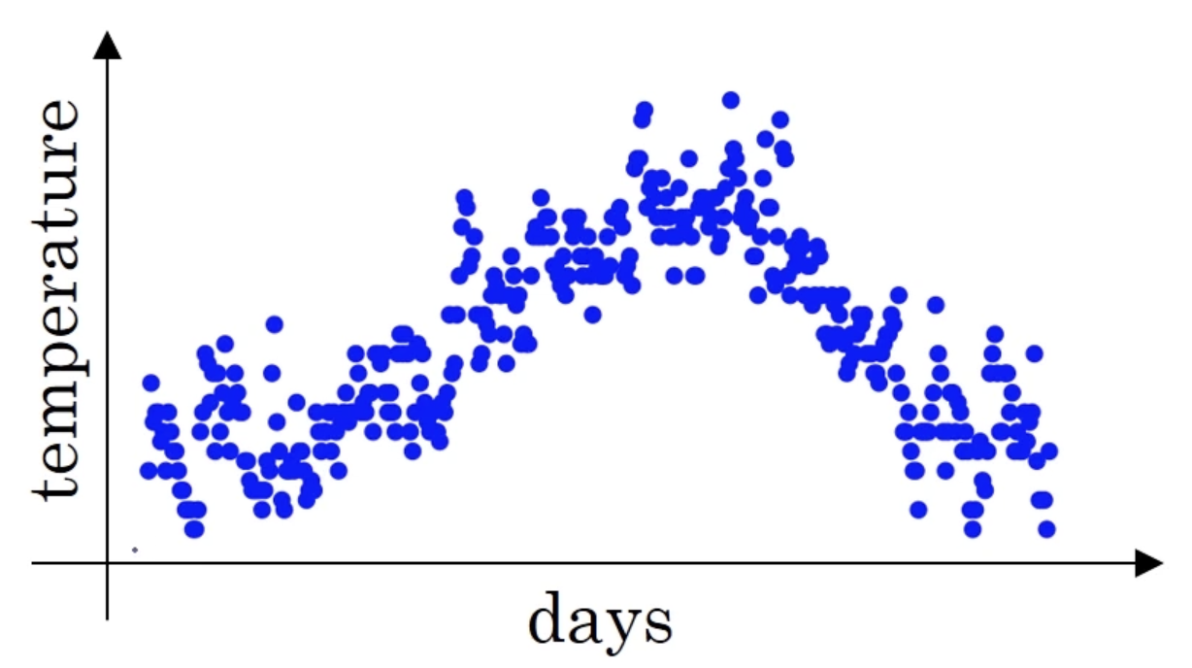
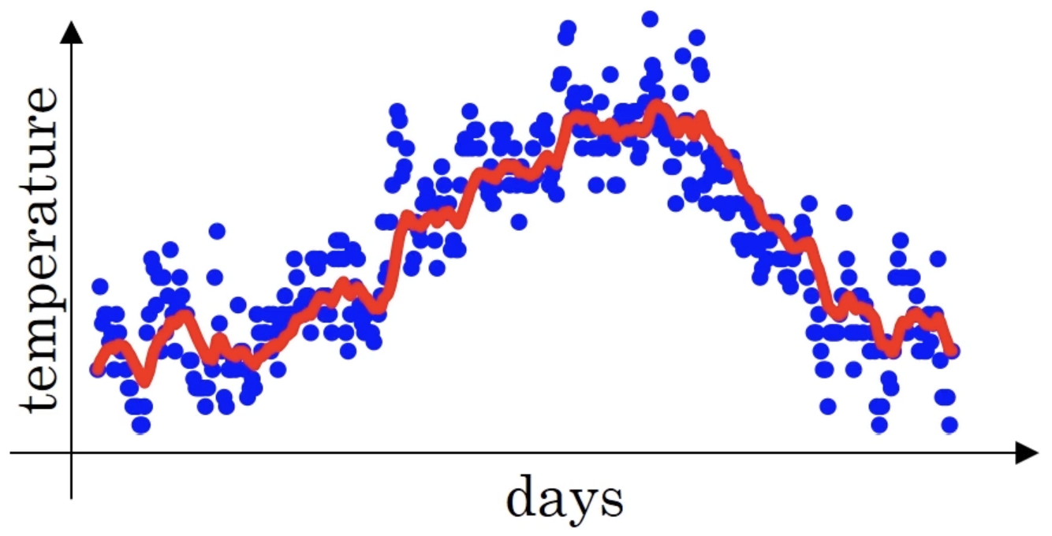
3. Deep Neural Network
Optimization: EWA
The exponentially weighted (moving) averages
Example: Temperatures
T₁ = 10
T₂ = 8
…
T_{n} = 3
The objective is to compute the “trend” of the temperature: V₀ = 0
V₁ = 0.9 * V₀ + 0.1 * T₁
V₂ = 0.9 * V₁ + 0.1 * T₂
…
V_{t} = 0.9 * V_{t-1} + 0.1 * T_{t}

Slide 11
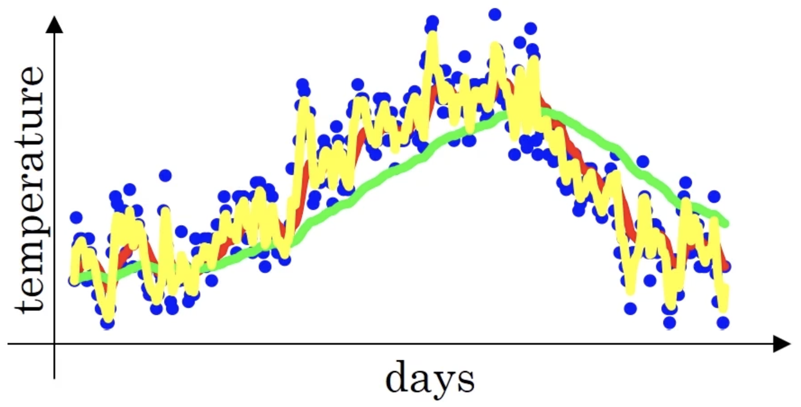
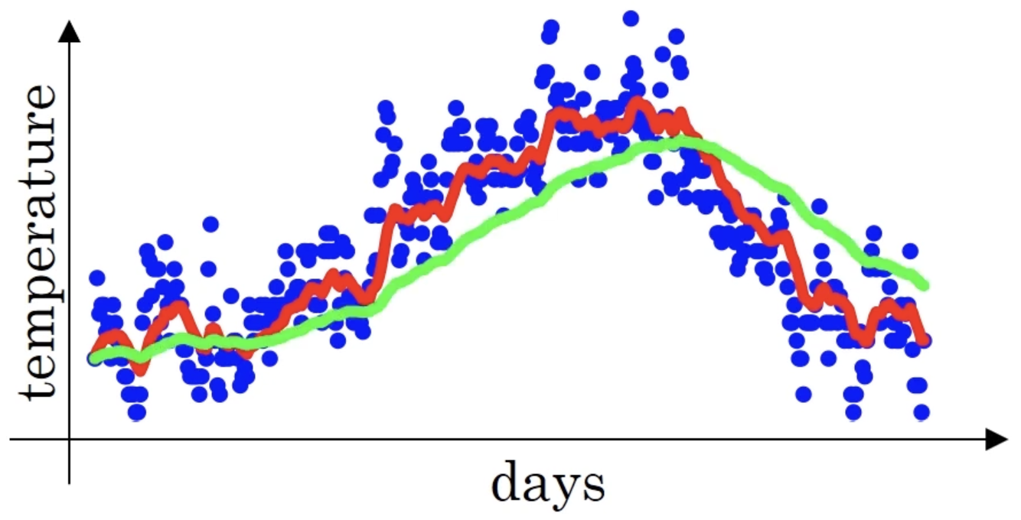


3. Deep Neural Network
Optimization: EWA
The exponentially weighted (moving) averages
$Vt=β Vt−1+\left(1−β\right) T_{t}$
$Vt≈average over \frac{1}{1−β} days$
if $β=0.90: average over≈10 days$
if $β=0.98: average over≈50 days$
if $β=0.50: average over≈2 days$

Slide 12
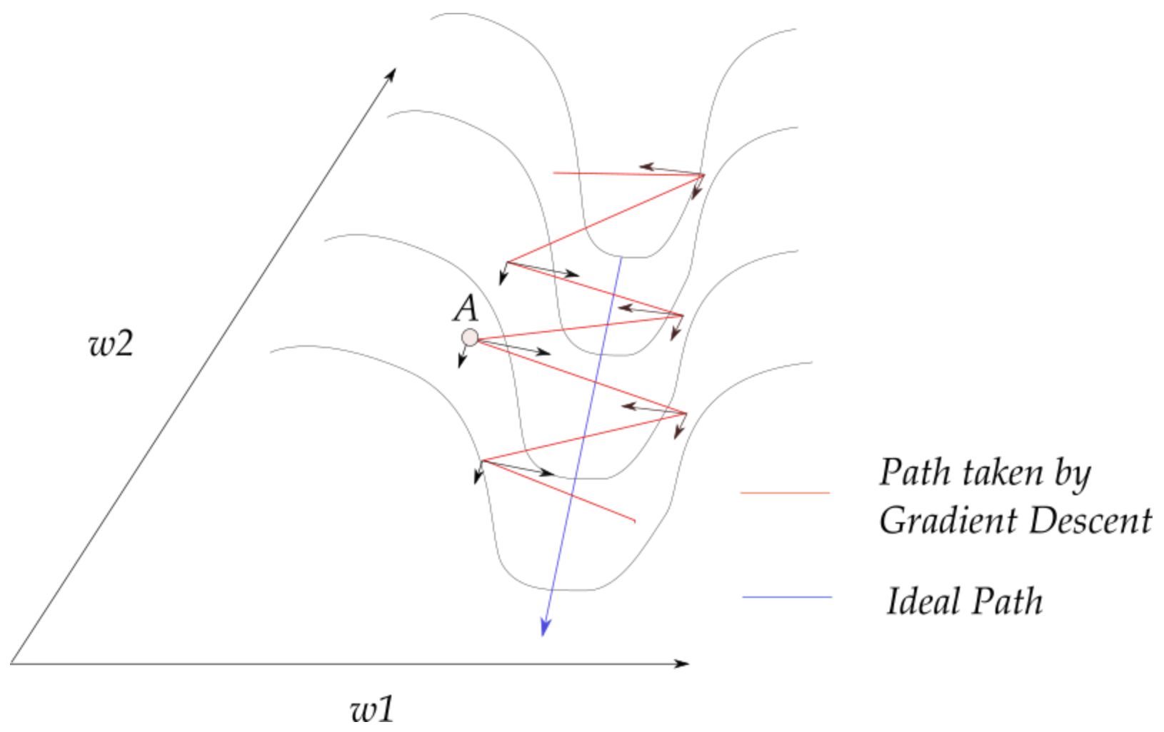
3. Deep Neural Network
Optimization: Grad. Descent with Momentum
Principle of Momentum:
Instead of using only the gradient of the current step to guide the search, momentum also accumulates the gradient of the past steps to determine the direction to go.
Notes:
Consider the image,and notice that most of the gradient updates are in a zig-zag direction. Also notice that each gradient update has been resolved into components along w1 and w2 directions. If we will individually sum these vectors up, their components along the direction w1 cancel out, while the component along the w2 direction is reinforced.
https://www.coursera.org/learn/intro-to-deep-learning/lecture/lYGBt/gradient-descent-extensions

Slide 13
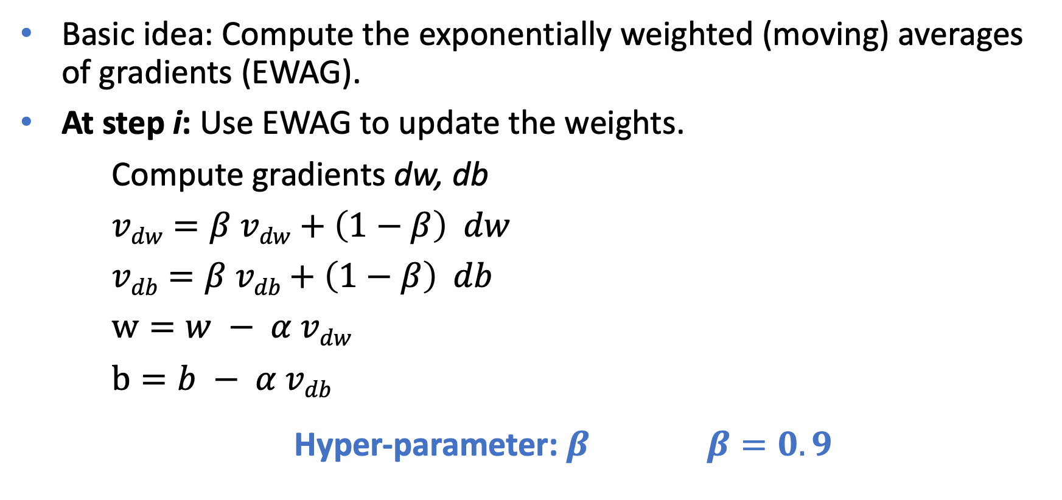
3. Deep Neural Network
Optimization: Grad. Descent with Momentum
Basic idea: Compute the exponentially weighted (moving) averages of gradients (EWAG).
At step i: Use EWAG to update the weights.
Compute gradients dw, db
$vdw=β vdw+\left(1−β\right) dw$
$vdb=β vdb+\left(1−β\right) db$
$w=w − α vdw$
$b=b − α vdb$
Hyper-parameter: $β β=0.9$
Notes:
Gradient descent with momentum: Its will almost always work better than the straightforward gradient descent algorithm without momentum.
Beta : coefficient of momentum
Beta = 0.9 : average over approx last 10 values of gradients.

Slide 14
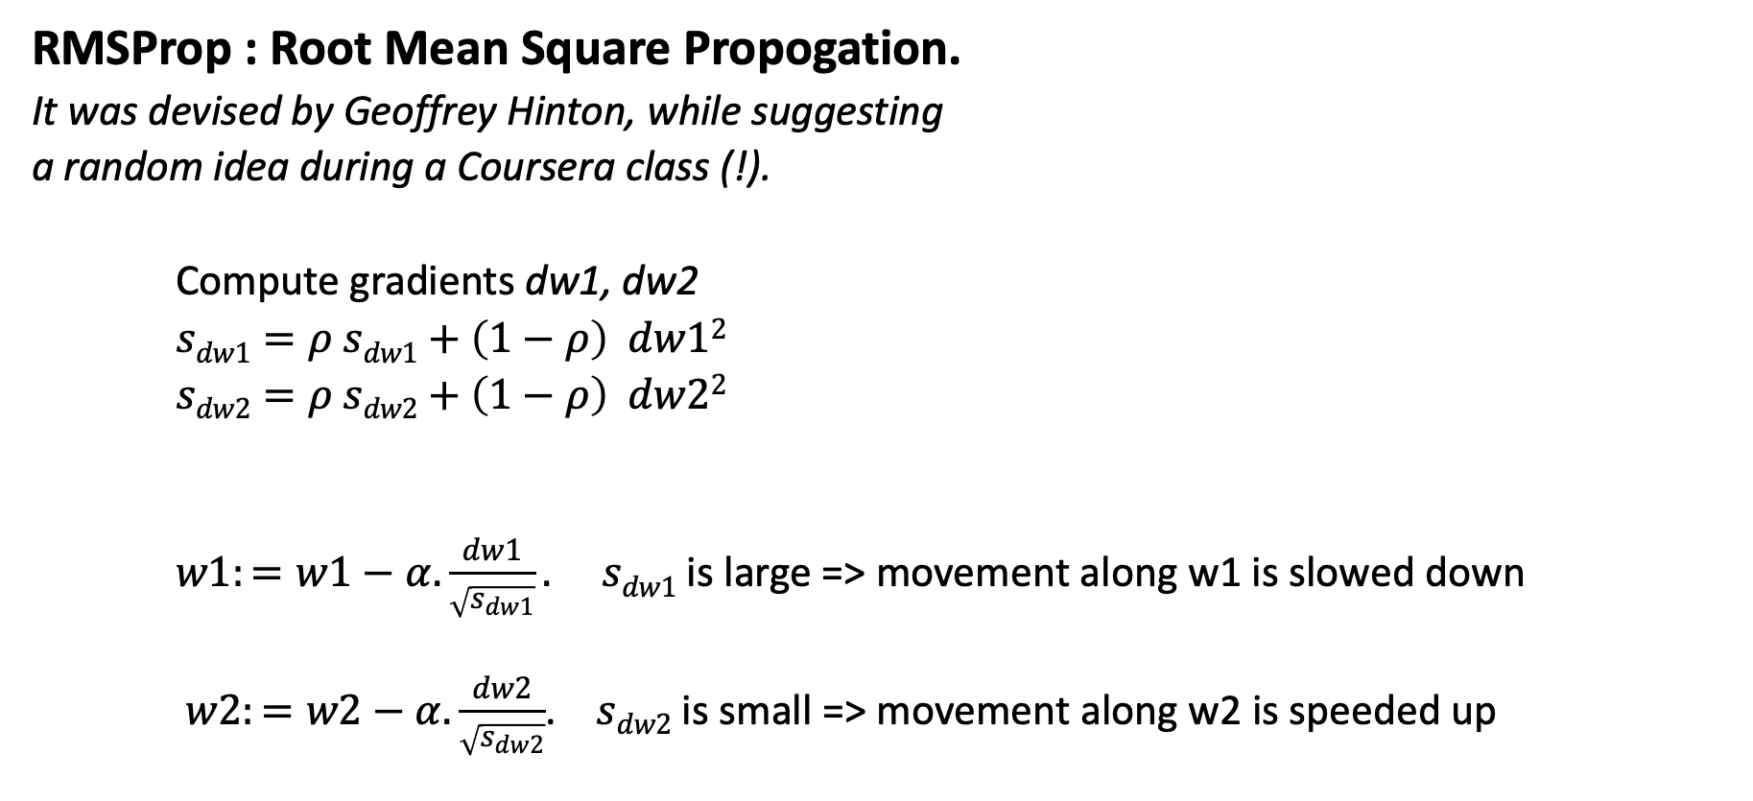
3. Deep Neural Network
Optimization: RMSProp
RMSProp : Root Mean Square Propogation.
It was devised by Geoffrey Hinton, while suggesting
a random idea during a Coursera class (!).
Compute gradients dw1, dw2
$sdw1=ρ sdw1+\left(1−ρ\right) dw12$
$sdw2=ρ sdw2+\left(1−ρ\right) dw22$
$w1:=w1−α.\frac{dw1}{\sqrt{s_{dw1}}}.$ $sdw1$ is large => movement along w1 is slowed down
$w2:=w2−α.\frac{dw2}{\sqrt{s_{dw2}}}$. $sdw2$ is small => movement along w2 is speeded up
Notes:
Root Mean Square Propogation has an interesting history. It was devised by the legendary Geoffrey Hinton, while suggesting a random idea during a Coursera class
Recall our example from before, that if you implement gradient descent, you can end up with huge oscillations in the vertical direction, even while it's trying to make progress in the horizontal direction. In order to provide intuition for this example, let's say that the vertical axis is the parameter b and horizontal axis is the parameter w. It could be w1 and w2 where some of the center parameters was named as b and w for the sake of intuition. And so, you want to slow down the learning in the b direction, or in the vertical direction. And speed up learning, or at least not slow it down in the horizontal direction. So this is what the RMSprop algorithm does to accomplish this. On iteration t, it will compute as usual the derivative dW, db on the current mini-batch.

Slide 15

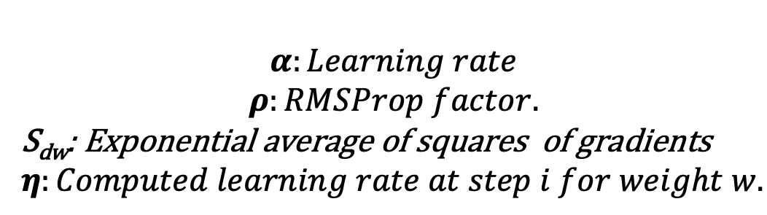
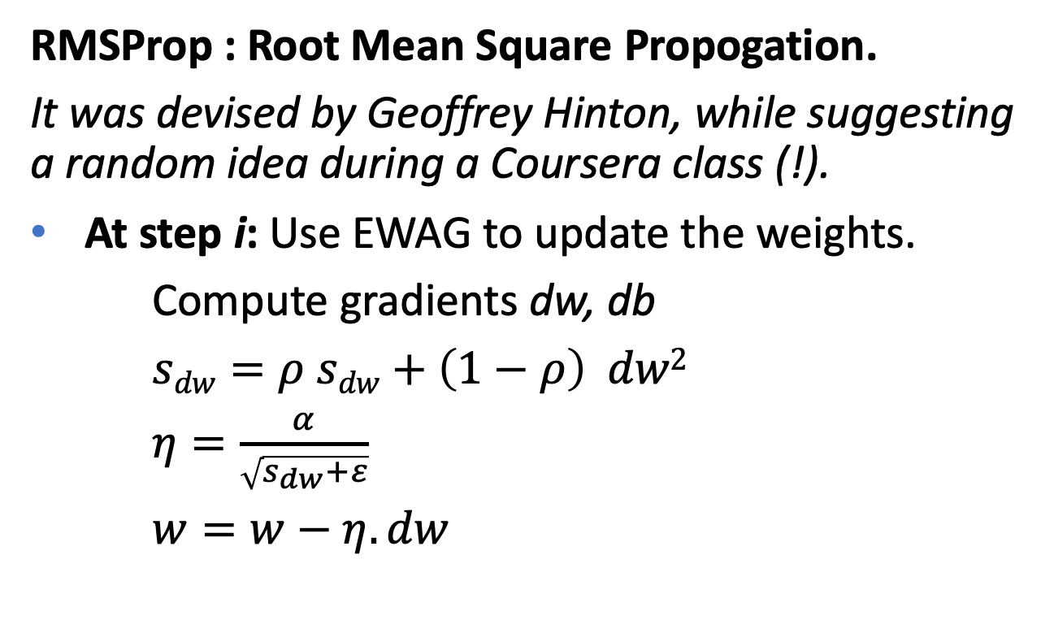
3. Deep Neural Network
Optimization: RMSProp
RMSProp : Root Mean Square Propogation.
It was devised by Geoffrey Hinton, while suggesting a random idea during a Coursera class (!).
At step i: Use EWAG to update the weights.
Compute gradients dw, db
$sdw=ρ sdw+\left(1−ρ\right) dw2$
$η=\frac{α}{\sqrt{s_{dw}+ε}}$
$w=w−η.dw$
$$α:Learning rate$$
$$ρ:RMSProp factor.$$
S_{dw}: Exponential average of squares of gradients
$η:Computed learning rate at step i for weight w.$
Hyper-parameter: $ρ=0.999$
Notes:
Root Mean Square Propogation has an interesting history. It was devised by the legendary Geoffrey Hinton, while suggesting a random idea during a Coursera class
Recall our example from before, that if you implement gradient descent, you can end up with huge oscillations in the vertical direction, even while it's trying to make progress in the horizontal direction. In order to provide intuition for this example, let's say that the vertical axis is the parameter b and horizontal axis is the parameter w. It could be w1 and w2 where some of the center parameters was named as b and w for the sake of intuition. And so, you want to slow down the learning in the b direction, or in the vertical direction. And speed up learning, or at least not slow it down in the horizontal direction. So this is what the RMSprop algorithm does to accomplish this. On iteration t, it will compute as usual the derivative dW, db on the current mini-batch.

Slide 16
3. Deep Neural Network
Optimization: Adam
A combination of Momentum and RMSProp.
It takes advantages of the two heuristics:
Momentum: Accelerates the search in direction of minima.
RMSPropo: Impedes the search in direction of oscillations.
ADAM -> Adaptive Moment Estimation.
Ref.: « ADAM: A METHOD FOR STOCHASTIC OPTIMIZATION ». ICLR 2015. By Diederik P. Kingma and Jimmy Lei Ba. https://arxiv.org/pdf/1412.6980.pdf

Slide 17
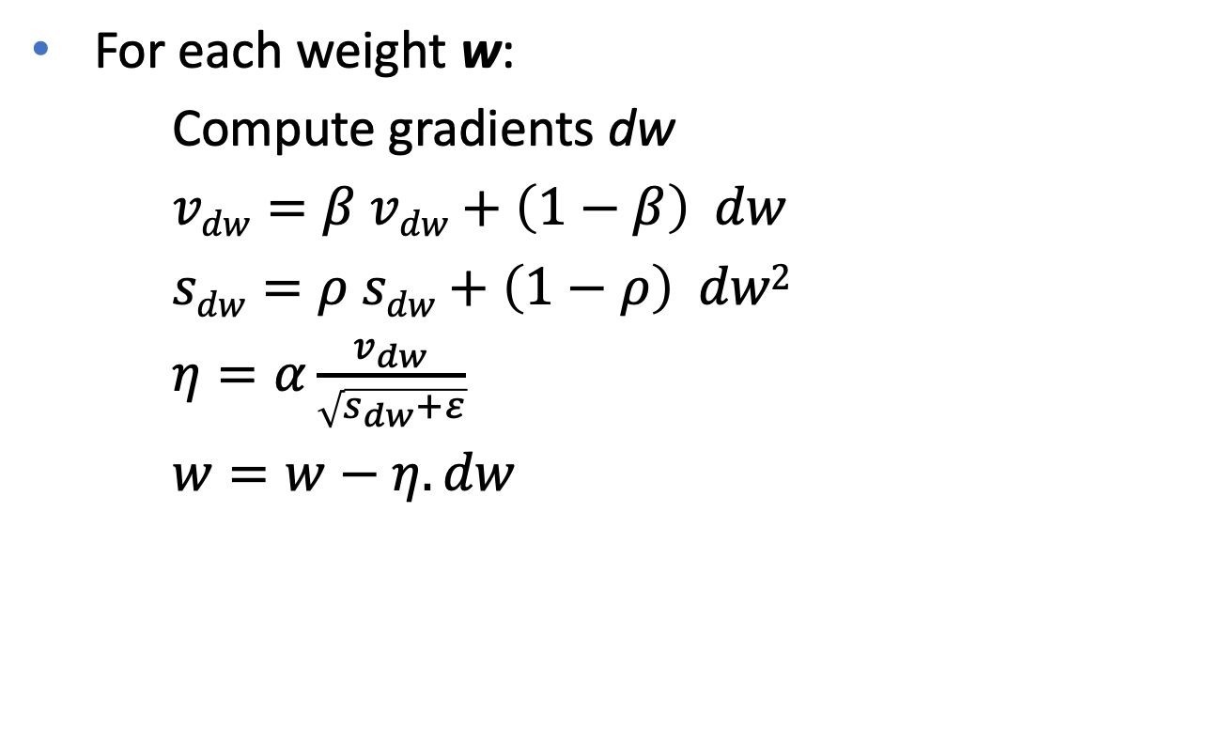

3. Deep Neural Network
Optimization: Adam
For each weight w:
Compute gradients dw
$vdw=β vdw+\left(1−β\right) dw$
$sdw=ρ sdw+\left(1−ρ\right) dw2$
$η=α\frac{v_{dw}}{\sqrt{s_{dw}+ε}}$
$w=w−η.dw$
$$α:Learning rate$$
$$β:Momentum factor.$$
$$ρ:RMSProp factor.$$
v_{dw}: Exponential average of gradients (dw)
S_{dw}: Exponential average of squares of gradients (dw)
$η:Computed learning rate at step i for weight w.$

Slide 18
3. Deep Neural Network
Optimization: Momentum, RMSProp, Adam
This introduces four hyper-parameters:
⍺: The initial learning rate => Need to be tunes.
β₁: Momentum factor => Default value = 0.9.
β₂: RMSProp factor => Default value = 0.999.
𝞮: Internal parameter => Default value = 10⁻⁸.

Slide 19
3. Deep Neural Network
Optimization: Momentum, RMSProp, Adam
We have seen three optimization methods
Objective of these methods:
  Deal with the problem of pathological curvature.
  speed up the search from the optimal parameters during training.
These methods are also called "Adaptive Methods" since the learning step is adapted according to the topology of the contour.

Slide 20
3. Deep Neural Network
Optimization: Learning Rate Decay
A unique and fixed learning rate has many drawbacks.
A dynamic and variable learning rate is required:
  Early learning epochs may require a large learning rate
  => We are still very far from the solution (minimum)
  When we get close to the solution, a smaller learning rate is required
  => Fine tune the solution.
  => Avoid turning around the solution without converging.
Notes:
https://towardsdatascience.com/learning-rate-schedules-and-adaptive-learning-rate-methods-for-deep-learning-2c8f433990d1

Slide 21
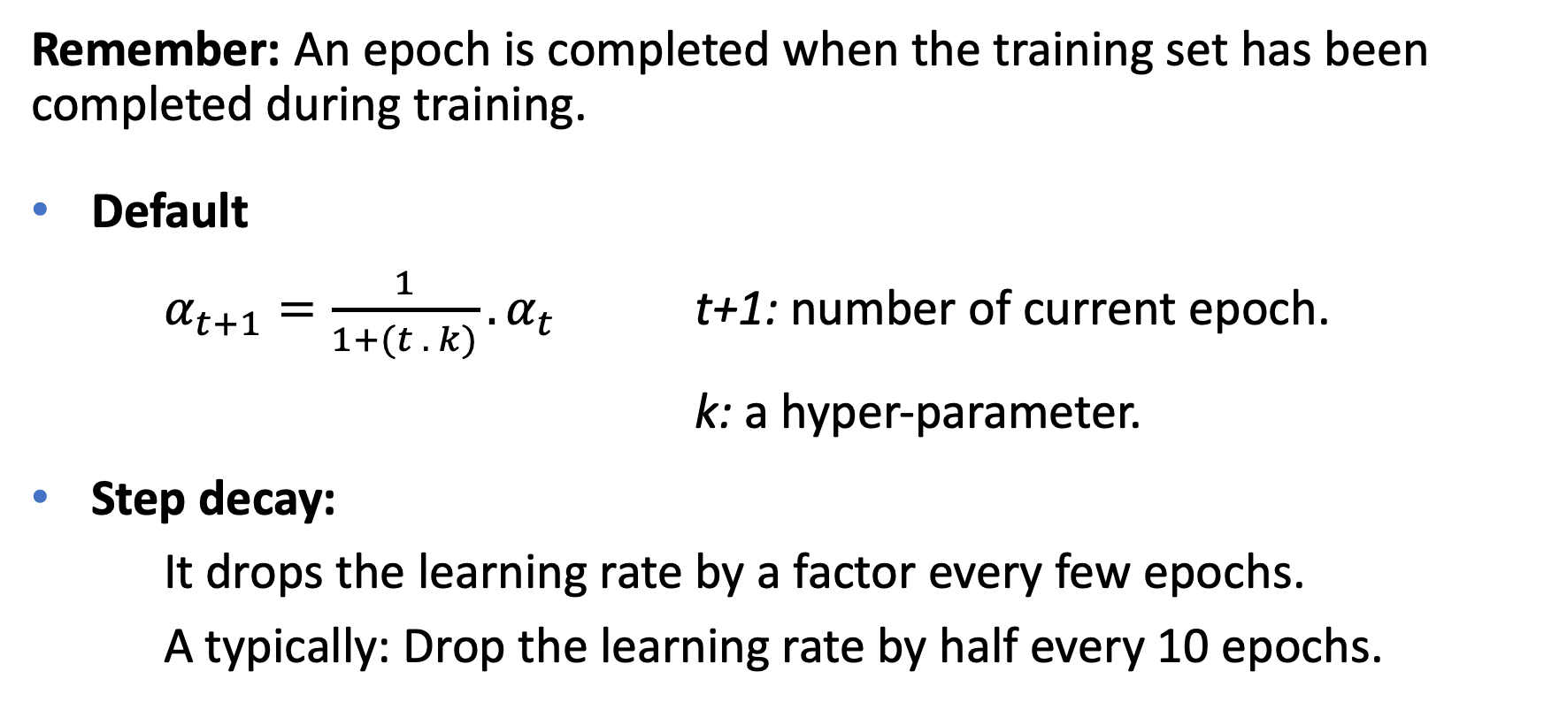
3. Deep Neural Network
Optimization: Learning Rate Decay
Remember: An epoch is completed when the training set has been completed during training.
Default
$α_{t+1}={\frac{1}{1+(t . k)}.α}_{t}$ t+1: number of current epoch.
k: a hyper-parameter.
Step decay:
It drops the learning rate by a factor every few epochs.
A typically: Drop the learning rate by half every 10 epochs.
Notes:
https://towardsdatascience.com/learning-rate-schedules-and-adaptive-learning-rate-methods-for-deep-learning-2c8f433990d1

Slide 22
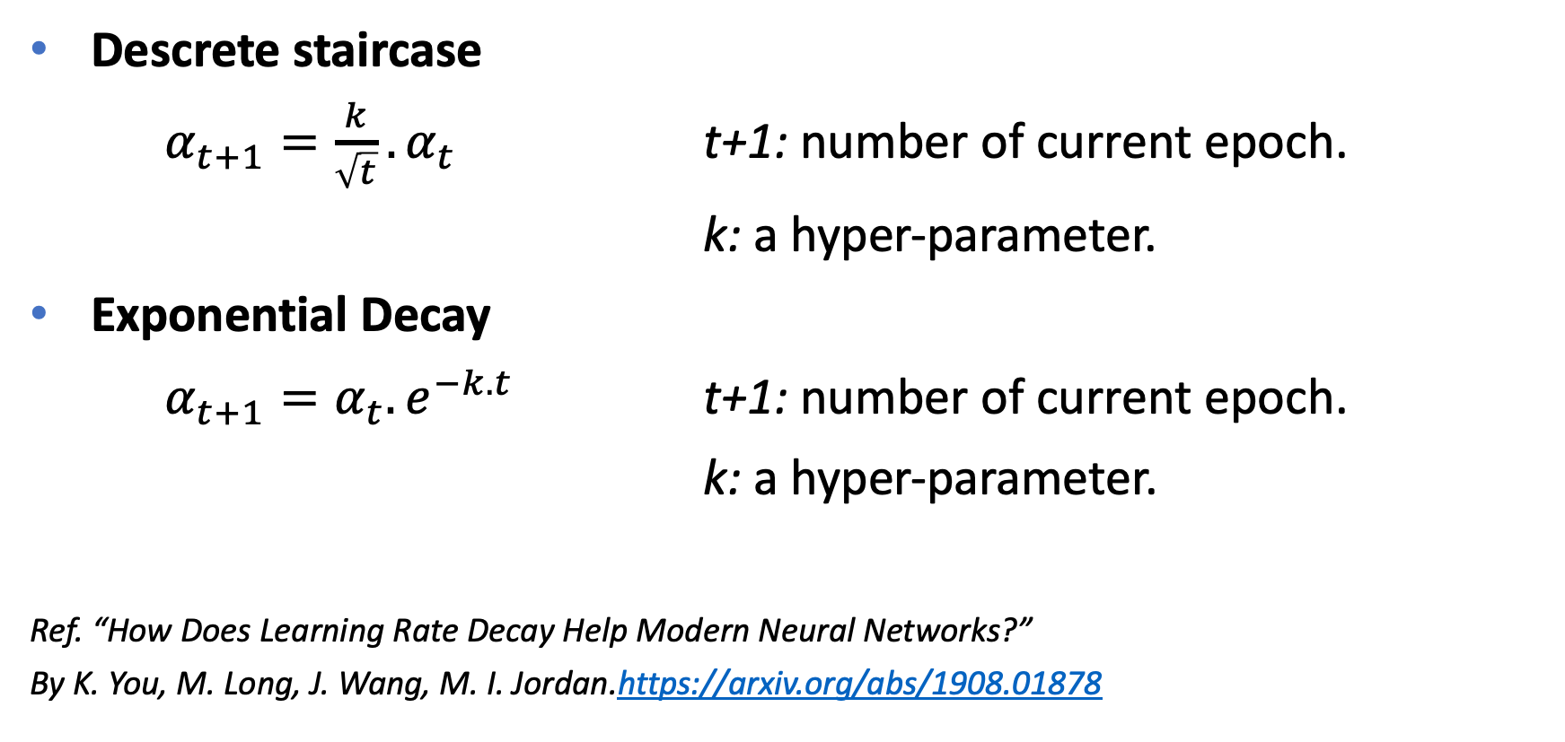
3. Deep Neural Network
Optimization: Learning Rate Decay
Descrete staircase
$α_{t+1}={\frac{k}{\sqrt{t}}.α}_{t}$ t+1: number of current epoch.
k: a hyper-parameter.
Exponential Decay
$α_{t+1}=α_{t}.e^{−k.t}$ t+1: number of current epoch.
k: a hyper-parameter.
Ref. “How Does Learning Rate Decay Help Modern Neural Networks?”
By K. You, M. Long, J. Wang, M. I. Jordan.https://arxiv.org/abs/1908.01878
Notes:
https://towardsdatascience.com/learning-rate-schedules-and-adaptive-learning-rate-methods-for-deep-learning-2c8f433990d1
One other thing that people sometimes do, is manual decay. And so if you're training just one model at a time, and if your model takes many hours, or even many days to train. What some people will do, is just watch your model as it's training over a large number of days.
And then manually say, it looks like the learning rate slowed down, I'm going to decrease alpha a little bit. Of course this works, this manually controlling alpha, really tuning alpha by hand, hour by hour, or day by day. This works only if you're training only a small number of models, but sometimes people do that as well. So now you have a few more options for how to control the learning rate alpha.

Slide 23
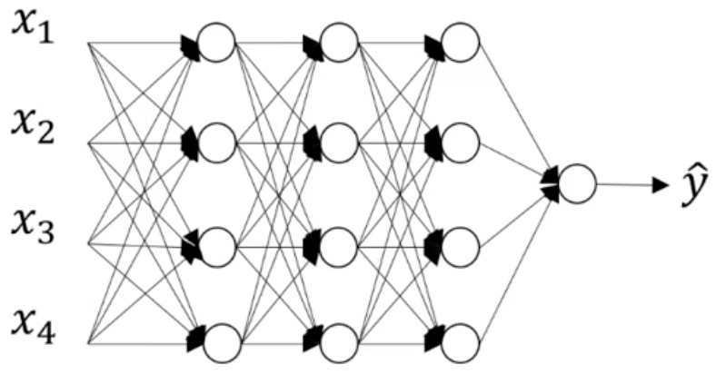



3. Deep Neural Network
Multi-class problem
We need to generalize (from binary classification) to multiple classes categorization.
From Cat/Non-Cat problem => Classify animals: cat, dogs, cow, birds, fish...
If we have 3 classes: Dogs, Cats, others.
Dog $P\left(dog | x\right)$
Cat $P\left(cat | x\right)$
Sigmoid
Other $P\left(other | x\right)$

Slide 24




3. Deep Neural Network
Multi-class problem – Sofmax
$z^{\left[4\right]}=w^{4}a^{3}+b^{\left[4\right]}$
Activation function:
  $t=e^{z^{\left[4\right]}}$ (3,1) dim-vector.
  $a_{i}^{\left[4\right]}=\frac{t_{i}}{\sum_{j=1}^{3}{t_{j} }} ∈ \left[0,1\right]$
Loss function: Softmax cross entropy / Categorical Cross-Entropy:
  $ℒ\left(\hat{y},y\right)=−\sum_{i=1}^{\#classes}{y_{i} log⁡({\hat{y}}_{i})}$ $\hat{y}:output; y:groudtruth.$
  Exercise
Dog $P\left(dog | x\right)$
Cat $P\left(cat | x\right)$
Sigmoid
Other $P\left(other | x\right)$
Layer4
Layer3
Notes:
Different names of cross entropy loss:
https://gombru.github.io/2018/05/23/cross_entropy_loss/

Slide 25
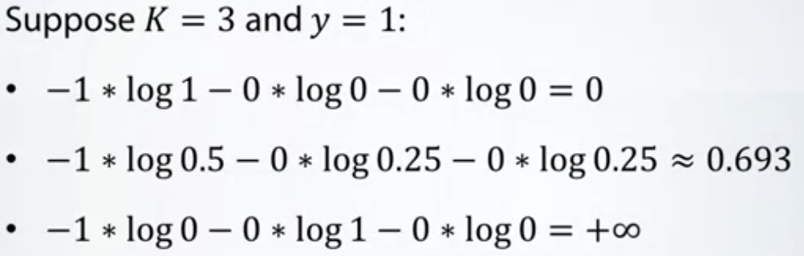
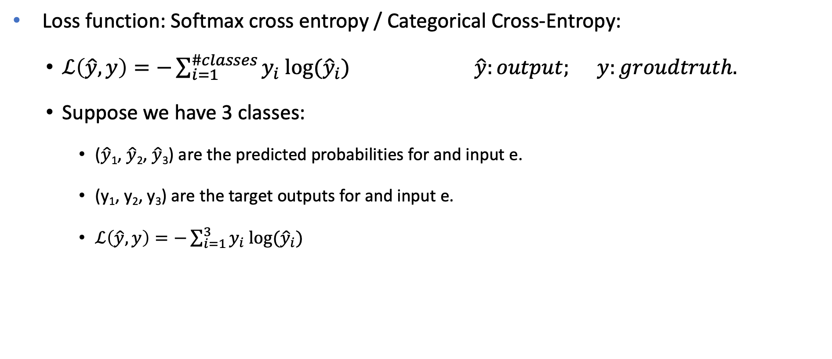
3. Deep Neural Network
Multi-class problem – Sofmax
Loss function: Softmax cross entropy / Categorical Cross-Entropy:
  $ℒ\left(\hat{y},y\right)=−\sum_{i=1}^{\#classes}{y_{i} log⁡({\hat{y}}_{i})}$ $\hat{y}:output; y:groudtruth.$
  Suppose we have 3 classes:
    ($\hat{y}$₁, $\hat{y}$₂, $\hat{y}$₃) are the predicted probabilities for and input e.
    (y₁, y₂, y₃) are the target outputs for and input e.
    $ℒ\left(\hat{y},y\right)=−\sum_{i=1}^{3}{y_{i} log⁡({\hat{y}}_{i})}$
Notes:
Different names of cross entropy loss:
https://gombru.github.io/2018/05/23/cross_entropy_loss/

Slide 26
3. Deep Neural Network
Hyper-parameters
Learning rate.
Momentum factor 0.9
RMSProp factor 0.999
Adam parameters (0.9, 0.999, 10⁻⁸).
Network architecture: Number of layers, numbers of neurons in hidden layers.
Learning rate decay method + internal parameters
Mini batch-size
Notes:
Now you know most of the elementary parts that required to build and to train a NN.
Unfortunately: each step reqiures to set a of parameters that we call Hyper parameters.
What are these parameters…
Your know how and expertise in this domain heavily rely on your ability to understand how these internal machenery work and the intuition you have on how to set these parameters.
… You need to practice ! You need to undestand things deeply!
The analogy with how Artificiel NN are trained.
These hyperpameters has to be reviewed periodically: even if you stay in the same application and you have worked deeply on hypermaters. => Hyper-parameters / field. Intersteing but should be revisited periodically…

Slide 27
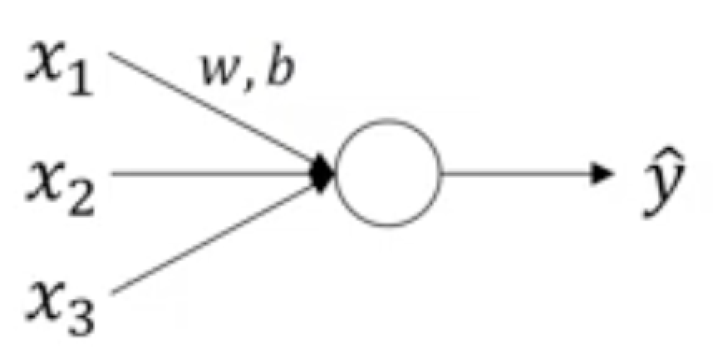
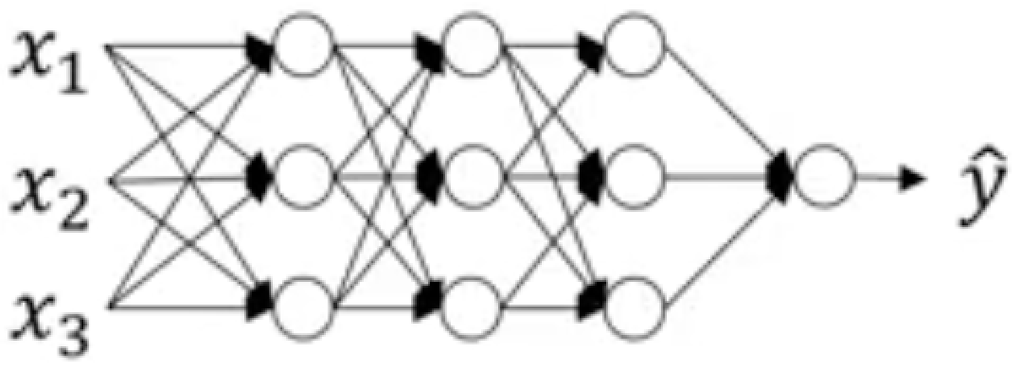
3. Deep Neural Network
Batch normalization
Proposed by Sergey Ioffe & Christian Szegedy
Batch Normalization: Accelerating Deep Network Training by Reducing Internal Covariate Shift, International Conference on Machine Learning 2015.
https://arxiv.org/abs/1502.03167
Normalizing inputs is essential !
Can we normalize the activations of a hidden layer in order to efficiently learn the parameters of the next layer ?

Slide 28
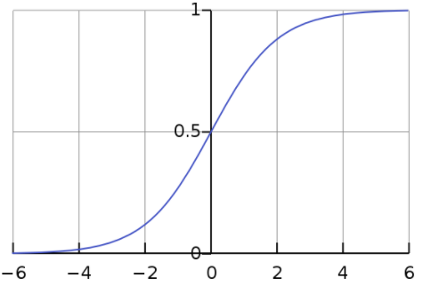
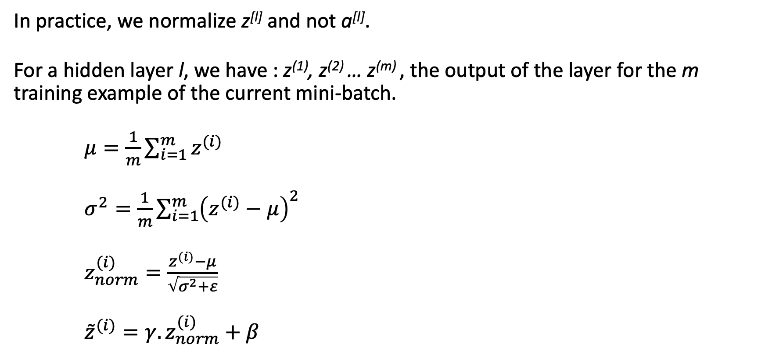

3. Deep Neural Network
Batch normalization
In practice, we normalize z^{[l]} and not a^{[l]}.
For a hidden layer l, we have : z⁽¹⁾, z⁽²⁾ … z^{(m)} , the output of the layer for the m training example of the current mini-batch.
$μ=\frac{1}{m}\sum_{i=1}^{m}{z^{(i)}}$
$σ^{2}=\frac{1}{m}\sum_{i=1}^{m}{{\left(z^{(i)}−μ\right)}^{2}}$
$z_{norm}^{(i)}=\frac{z^{(i)}−μ}{\sqrt{σ^{2}+ε}}$
${\tilde{z}}^{(i)}={γ.z}_{norm}^{(i)}+β$
Here $γ$and $β$are parameters.
trainable

Slide 29

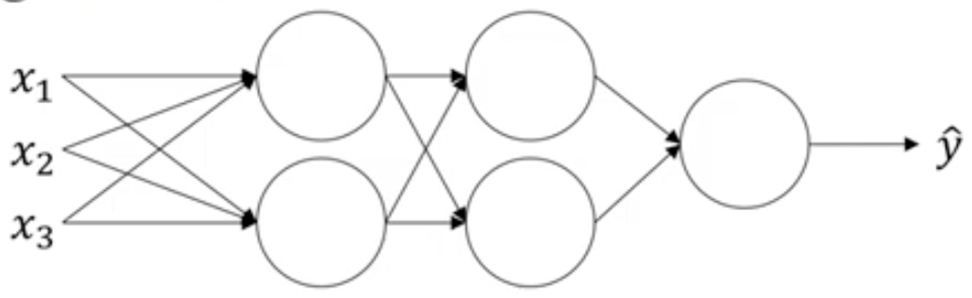







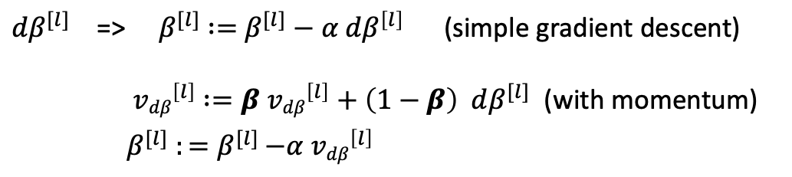









3. Deep Neural Network
Batch normalization
tf.nn.batch-normalization
During forward propagation: use ${\tilde{z}}^{(i)}$ instead of $z^{(i)}$.
$X \underset{→}{w^{[1]},{ b}^{[1]}}Z^{[1]}\underset{→}{γ^{[1]},β^{[1]}}{\tilde{Z}}^{[1]}\underset{→}{g }A^{[1]}$ $\underset{→}{w^{[2]},{ b}^{[2]}}Z^{[2]}\underset{→}{γ^{[2]},β^{[2]}}{\tilde{Z}}^{[2]}$ $\underset{→}{g }A^{[2]} \underset{→}{w^{[3]},{ b}^{[3]}}Z^{[3]}\underset{→}{γ^{[3]},β^{[3]}}{\tilde{Z}}^{[3]}$ $\underset{→}{g }A^{[3]}=\hat{Y}$
Trainable parameters:
$w^{[1]},{ b}^{[1]}$, $w^{[2]},{ b}^{[2]}$, $w^{[3]},{ b}^{[3]}$
$$γ^{[1]},β^{[1]}{, γ}^{[2]},β^{[2]},γ^{[3]},β^{[3]}$$
$$z_{1}^{[1]}$$
$$z_{1}^{[2]}$$
$$a_{1}^{[2]}$$
$$a_{1}^{[1]}$$
$${\tilde{z}}_{1}^{[1]}$$
$${\tilde{z}}_{1}^{[2]}$$
$$z_{1}^{[3]}$$
$$a_{1}^{[3]}$$
$${\tilde{z}}_{1}^{[3]}$$
$$z_{2}^{[1]}$$
$$z_{2}^{[2]}$$
$$a_{2}^{[1]}$$
$$a_{2}^{[2]}$$
$${\tilde{z}}_{2}^{[1]}$$
$${\tilde{z}}_{2}^{[2]}$$
${dβ}^{[l]}$ => $β^{[l]}$ $:=$ $β^{[l]}−α{ dβ}^{\left[l\right]}$ (simple gradient descent)
${ vdβ}^{\left[l\right]} :=β{ vdβ}^{\left[l\right]}+\left(1−β\right) dβ^{[l]}$ (with momentum)
$β^{[l]}$ ${:=β}^{[l]}−α{ vdβ}^{\left[l\right]}$

Slide 30
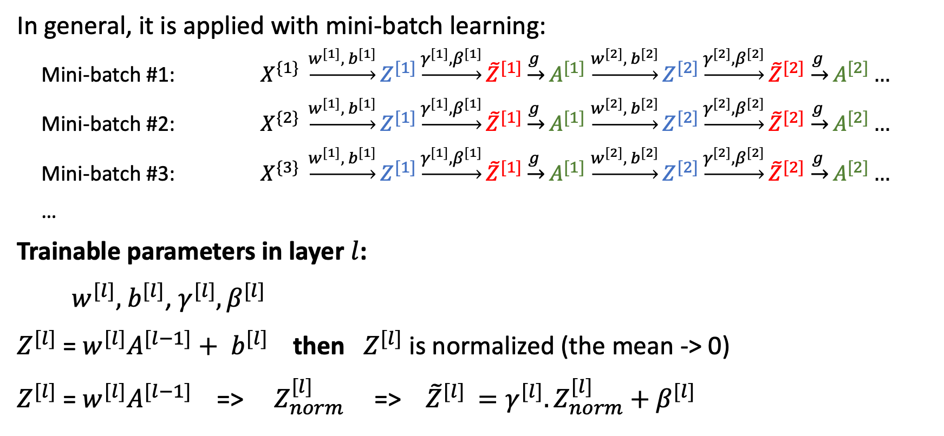
3. Deep Neural Network
Batch normalization
In general, it is applied with mini-batch learning:
  Mini-batch #1: $X^{\{1\}} \underset{→}{w^{[1]},{ b}^{[1]}}Z^{[1]}\underset{→}{γ^{[1]},β^{[1]}}{\tilde{Z}}^{[1]}\underset{→}{g }A^{[1]}$ $\underset{→}{w^{[2]},{ b}^{[2]}}Z^{[2]}\underset{→}{γ^{[2]},β^{[2]}}{\tilde{Z}}^{[2]}$ $\underset{→}{g }A^{[2]}…$
  Mini-batch #2: $X^{\{2\}} \underset{→}{w^{[1]},{ b}^{[1]}}Z^{[1]}\underset{→}{γ^{[1]},β^{[1]}}{\tilde{Z}}^{[1]}\underset{→}{g }A^{[1]}$ $\underset{→}{w^{[2]},{ b}^{[2]}}Z^{[2]}\underset{→}{γ^{[2]},β^{[2]}}{\tilde{Z}}^{[2]}$ $\underset{→}{g }A^{[2]}…$
  Mini-batch #3: $X^{\{3\}} \underset{→}{w^{[1]},{ b}^{[1]}}Z^{[1]}\underset{→}{γ^{[1]},β^{[1]}}{\tilde{Z}}^{[1]}\underset{→}{g }A^{[1]}$ $\underset{→}{w^{[2]},{ b}^{[2]}}Z^{[2]}\underset{→}{γ^{[2]},β^{[2]}}{\tilde{Z}}^{[2]}$ $\underset{→}{g }A^{[2]}…$
  …
Trainable parameters in layer $l$:
$w^{[l]},{ b}^{[l]}$, $γ^{[l]},β^{[l]}$
$Z^{[l]}$ = $w^{[l]}A^{[l−1]}+$ ${ b}^{[l]}$ then $Z^{[l]}$ is normalized (the mean -> 0)
$Z^{[l]}$ = $w^{[l]}A^{[l−1]}$ => $Z_{norm}^{[l] }$ => ${\tilde{Z}}^{[l] }={γ^{[l]}.Z}_{norm}^{[l]}+β^{[l]}$

Slide 31
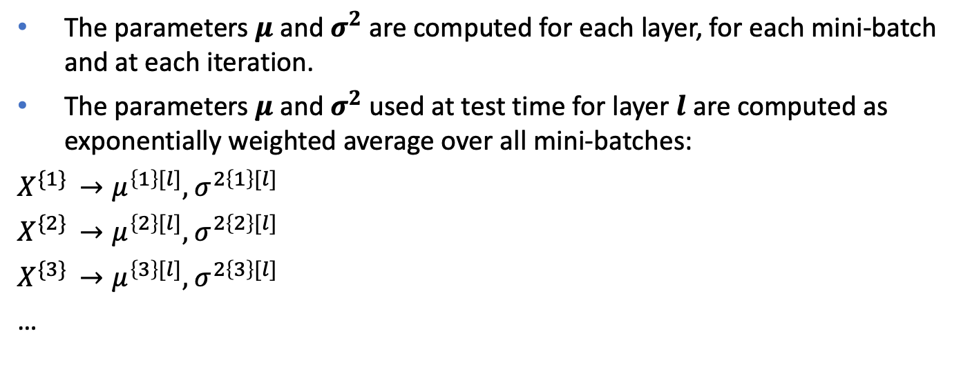
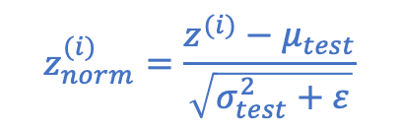
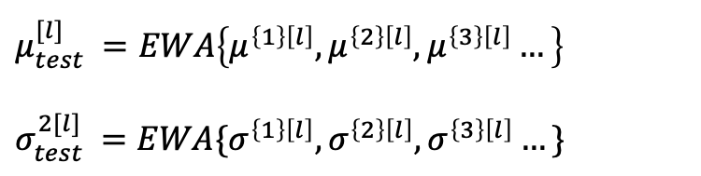
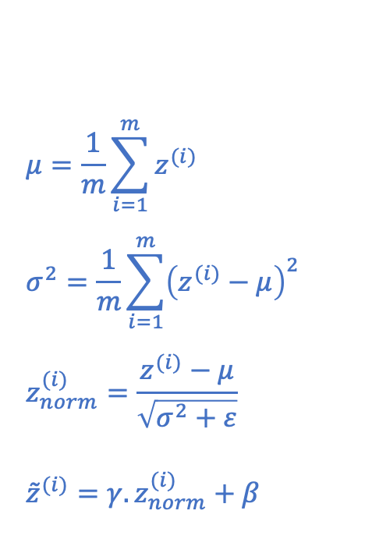
3. Deep Neural Network
Batch normalization
What about the test time?
During training, inputs are processed by batch or mini-batches
During test time, input are processed one by one.
$$μ=\frac{1}{m}\sum_{i=1}^{m}{z^{(i)}}$$
$$σ^{2}=\frac{1}{m}\sum_{i=1}^{m}{{\left(z^{(i)}−μ\right)}^{2}}$$
$$z_{norm}^{(i)}=\frac{z^{(i)}−μ}{\sqrt{σ^{2}+ε}}$$
${\tilde{z}}^{(i)}={γ.z}_{norm}^{(i)}+β$
The parameters $μ$ and $σ^{2}$ are computed for each layer, for each mini-batch and at each iteration.
The parameters $μ$ and $σ^{2}$ used at test time for layer $l$are computed as exponentially weighted average over all mini-batches:
$$X^{\{1\} }→μ^{\left\{1\right\}[l]},{ σ}^{2\left\{1\right\}[l]}$$
$$X^{\{2\} }→μ^{\left\{2\right\}[l]},{ σ}^{2\left\{2\right\}[l]}$$
$$X^{\{3\} }→μ^{\left\{3\right\}[l]},{ σ}^{2\left\{3\right\}[l]}$$
…
$${μ_{test}^{[l]}}^{ }=EWA\left\{μ^{\left\{1\right\}\left[l\right]},μ^{\left\{2\right\}\left[l\right]},μ^{\left\{3\right\}\left[l\right]}…\right\}$$
$${σ_{test}^{2[l]}}^{ }=EWA\{σ^{\left\{1\right\}\left[l\right]},σ^{\left\{2\right\}\left[l\right]},σ^{\left\{3\right\}\left[l\right]}…\}$$
$$z_{norm}^{(i)}=\frac{z^{(i)}−μ_{test}}{\sqrt{σ_{test}^{2}+ε}}$$

